Slide 1

© 2002, Cisco Systems, Inc. All rights reserved.

Slide 2

Configuring VLANs
© 2002, Cisco Systems, Inc. All rights reserved.
Notes:
Purpose: This chapter introduces the Cisco IOS™ CLI on the Catalyst® 1900 switch and router.
Timing: This chapter should take about 2 hours to present.
Note: The Catalyst 1900 switch only has a subset of the router Cisco IOS commands available.
Contents:
Introduction to Cisco IOS. Explain to the student what is IOS?
Cisco Device startup procedures in general.
IOS configuration source.
General introduction to the IOS CLI.
Cat 1900 switch startup procedures.
Intro to Cat 1900 CLI. This part covers the basic configuration on the switch, like setting the IP address and hostname. More details about the various Cat 1900 switch configuration commands are explained in Chapter 6 and 7.
Router startup procedures. More details on the router startup process is discussed in chapter 5.
Router IOS CLI.

Slide 3
Objectives
Upon completing this lesson, you will be able to:
  Use Cisco IOS commands to configure VLANs, VTP, IEEE 802.1Q trunking, and ISL trunking, given a functioning access layer switch
  Execute an add, move, or change on an access-layer switch, given a new network requirement
  Use show commands to identify anomalies in VLAN, VTP, IEEE 802.1Q trunking, ISL trunking, and spanning-tree operation within a VLAN, given an operational access layer switch
  Use debug commands to identify events and anomalies in VLAN, VTP, IEEE 802.1Q trunking, ISL trunking, and spanning-tree operation, given an operational access layer switch
Notes:
Slide 1 of 2
Purpose: This slide states the chapter objectives.
Emphasize: Read or state each objective so that each student has a clear understanding of the chapter objectives.
Note: Catalyst switches have different CLIs. The Catalyst 2900xl and the Catalyst 1900 has a Cisco IOS CLI. The Cisco IOS CLI commands available on the 2900xl is different from the 1900. The Catalyst 5000 family has no Cisco IOS CLI, and use the set commands instead. This class only covers the configuration on the Catalyst 1900 switch.

Slide 4
VTP Configuration Guidelines
  VTP domain name
  VTP mode (server/client/transparent)—VTP server mode is the default
  VTP pruning
  VTP password
  VTP trap
Use caution when adding a new switch to an existing domain. Add a new switch in client mode to prevent the new switch from propagating incorrect VLAN information.
Use the delete vtp command to reset the VTP revision number.
Notes:
Notes: All switches in a VTP domain must run the same VTP version.
The password entered with a domain name should be the same for all switches in the domain. If you configure a VTP password, the management domain will not function properly if you do not assign the management domain password to each switch in the domain.
A VTP version 2-capable switch can operate in the same VTP domain as a switch running VTP version 1, provided version 2 is disabled on the version 2-capable switch (version 2 is disabled by default).
Do not enable VTP version 2 on a switch unless all of the switches in the same VTP domain are version 2-capable. When you enable version 2 on a switch, all of the version 2-capable switches in the domain must have version 2 enabled. If there is a version 1-only switch, it will not exchange VTP information with switches with version 2 enabled.
If there are Token Ring networks in your environment, you must enable VTP version 2 for Token Ring VLAN switching to function properly.
Enabling or disabling VTP pruning on a VTP server enables or disables VTP pruning for the entire management domain.
In the lab, all the switches are set to VTP transparent mode.

Slide 5
Creating a VTP Domain
Catalyst 1900
wg_sw_1900(config)#vtp [server | transparent | client] [domain domain-name] [trap {enable | disable}] [password password] [pruning {enable | disable}]
wg_sw_1900#configure terminal
Enter configuration commands, one per line. End with CNTL/Z
wg_sw_1900(config)#vtp transparent
wg_sw_1900(config)#vtp domain switchlab
Catalyst 2950
wg_sw_2950#vlan database
wg_sw_2950(vlan)#vtp [ server | client | transparent ]
wg_sw_2950(vlan)#vtp domain domain-name
wg_sw_2950(vlan)#vtp password password
wg_sw_2950(vlan)#vtp pruning
wg_sw_2950(vlan)#snmp-server enable traps vtp
wg_sw_2950(vlan)#exit
Notes:
Layer 2 of 2
Note: The two commands shown in the slide can also be combined into one command:
vtp domain switchlab transparent

Slide 6
VTP Configuration Example
wg_sw_1900(config)#vtp transparent
wg_sw_1900(config)#vtp domain switchlab pruning enable
wg_sw_1900(config)#exit
wg_sw_1900#show vtp
VTP version: 1
Configuration revision: 4
Maximum VLANs supported locally: 1005
Number of existing VLANs: 6
VTP domain name : switchlab
VTP password :
VTP operating mode : Transparent
VTP pruning mode : Enabled
VTP traps generation : Enabled
Configuration last modified by: 0.0.0.0 at 00-00-0000
00:00:00
wg_sw_1900#config terminal
wg_sw_1900(config)#interface f0/26
wg_sw_1900(config-if)#trunk on desirable
wg_sw_1900(config-if)#exit
wg_sw_1900(config)#exit
wg_sw_1900#show trunk A
DISL state: On, Trunking: On, Encapsulation type: ISL

Slide 7
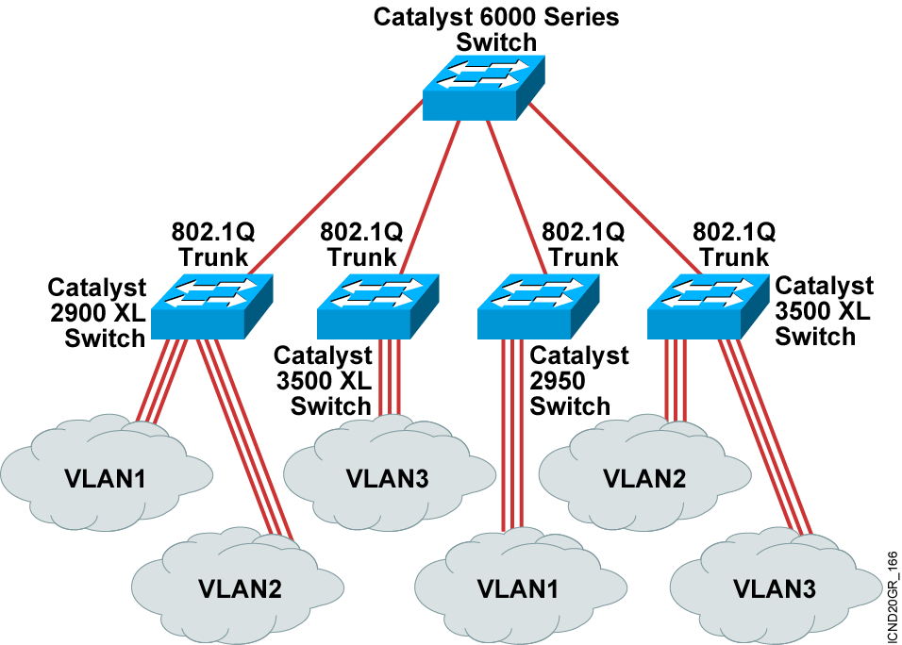
802.1Q Trunking Limitations
Make sure the native VLAN for an 802.1Q trunk is the same on both ends of the trunk link.
Make sure your network is loop-free before disabling STP.

Slide 8
Configuring
802.1Q Trunking
wg_sw_a(config-if)#switchport mode trunk
Configures the port as a VLAN trunk

Slide 9
Configuring ISL Trunking
wg_sw_1900(config-if)#trunk [on | off | desirable | auto | nonegotiate]
on = Set trunk on and negotiate with other side
off = Set trunk off and negotiate with other side
desirable = Negotiate with other side;
trunk on if other side is on, desirable, or auto
auto = Will be a trunk only if the other side is on or desirable
nonnegotiate = Set trunk on and will not negotiate
wg_sw_1900#conf terminal
Enter configuration commands, one per line. End with CNTL/Z
wg_sw_1900(config)#interface f0/26
wg_sw_1900(config-if)#trunk on
First Trunk Port (Port A)
Note: The Catalyst 1900 only supports ISL encapsulation.
Notes:
Layer 2 of 2

Slide 10
VLAN Configuration Guidelines
  Maximum number of VLANs is switch-dependent.
  Catalyst desktop switches support 64 VLANs with a separate spanning tree per VLAN.
  VLAN1 is the factory default Ethernet VLAN.
  CDP and VTP advertisements are sent on VLAN1.
  The Catalyst switch IP address is in the management VLAN (VLAN1 by default).
  To add or delete VLANs, the switch must be in VTP server or transparent mode.
Notes:
Note: In the ICND lab, all the switches and routers are in VLAN1. The core server and the core router are in multiple VLANs. Each workgroup PC is on an unique VLAN.

Slide 11
Adding a VLAN
Catalyst 1900
wg_sw_1900(config)# vlan vlan# [name vlan-name]
wg_sw_1900#configure terminal
Enter configuration commands, one per line. End with CNTL/Z
wg_sw_1900(config)#vlan 9 name switchlab2
Catalyst 2950
wg_sw_2950#vlan database
wg_sw_2950(vlan)# vlan vlan# [name vlan-name]
wg_sw_2950#vlan database
wg_sw_ 2950(vlan)#vlan 9 name switchlab2
wg_sw_ 2950(vlan)#exit
Notes:
Layer 2 of 2

Slide 12
Modifying a VLAN Name
wg_sw_a(config)#vlan vlan# name vlan-name
wg_sw_a#configure terminal
Enter configuration commands, one per line. End with CNTL/Z
wg_sw_a(config)#vlan 9 name switchlab90
wg_sw_a#show vlan 9
VLAN Name Status Ports
------------------------------------------------
9 switchlab90 Enabled
------------------------------------------------
Notes:
Note: The output shows that there are currently no ports assigned to VLAN9.

Slide 13
Assigning Switch Ports to a VLAN
Catalyst 1900
wg_sw_1900(config-if)#vlan-membership {static {vlan#} | dynamic}
wg_sw_1900#conf terminal
Enter configuration commands, one per line. End with CNTL/Z
wg_sw_1900(config)#interface ethernet 0/8
wg_sw_1900(config-if)#vlan-membership static 9
Catalyst 2950
wg_sw_2950(config-if)#switchport access vlan vlan#
Notes:
Layer 2 of 2
Note: In the lab, we will only be configuring static VLAN membership.

Slide 14
Verifying the VTP Configuration for the Catalyst 1900
wg_sw_1900#show vtp
wg_sw_1900#show vtp
VTP version: 1
Configuration revision: 4
Maximum VLANs supported locally: 1005
Number of existing VLANs: 6
VTP domain name : switchlab
VTP password :
VTP operating mode : Transparent
VTP pruning mode : Enabled
VTP traps generation : Enabled
Configuration last modified by: 10.1.1.40 at 00-00-0000 00:00:00
Notes:
Layer 2 of 2
Note: In the slide, the VLAN database was last modified locally. The IP address of wg_sw_a is 10.1.1.40.
In the lab, the 1900s are running version 8.01.01, and pruning was disabled by default. In the documentation, pruning is suppose to be enabled by default.

Slide 15
Verifying the VTP Configuration for the Catalyst 2950
wg_sw_2950#show vtp status
wg_sw_2950#show vtp status
VTP Version : 2 <--- Indicates v2-capable
Configuration Revision : 4
Maximum VLANs supported locally : 68
Number of existing VLANs : 6
VTP Operating Mode : Server
VTP Domain Name : switchlab
VTP Pruning Mode : Enabled
VTP V2 Mode : Disabled <--- Indicates v2 disabled; v1 set
VTP Traps Generation : Disabled <--- Catalyst 2950 default
MD5 digest : 0x3D 0x02 0xD4 0x3A 0xC4 0x46 0xA1 0x03
Configuration last modified by 10.1.1.40 at 5-4-02 22:25:
Notes:
Layer 2 of 2
Note: In the slide, the VLAN database was last modified locally. The IP address of wg_sw_a is 10.1.1.40.
In the lab, the 1900s are running version 8.01.01, and pruning was disabled by default. In the documentation, pruning is suppose to be enabled by default.

Slide 16
Verifying a Trunk
Catalyst 1900
wg_sw_1900#show trunk [A | B]
wg_sw_1900#show trunk a
DISL state: On, Trunking: On, Encapsulation type: ISL
Catalyst 2950
wg_sw_2950#show interface interface switchport
wg_sw_2950#show interface fa0/2 switchport
Name: Fa0/2
Switchport: Enabled
Administrative mode: trunk
Operational Mode: trunk
. . .
Notes:
Layer 2 of 2
Note: The Catalyst 1900,at the time of the beta, only supports ISL trunking. It does not support 802.1Q trunking.

Slide 17
Verifying a VLAN
Catalyst 1900
wg_sw_1900#show vlan [vlan#]
wg_sw_1900#show vlan 9
VLAN Name Status Ports
-------------------------------------------------
9 switchlab2 Enabled
-------------------------------------------------
VLAN Type SAID MTU Parent RingNo BridgeNo Stp Trans1 Trans2
---------------------------------------------------------------------------
9 Ethernet 100009 1500 0 1 1 Unkn 0 0
---------------------------------------------------------------------------
Catalyst 2950
wg_sw_2950#show vlan [id vlan#]
Notes:
Layer 2 of 2
Note:
Type: Default is Ethernet (other types are FDDI and Token Ring).
SAID: Is used for FDDI trunking.
MTU: Default is 1500 for Ethernet VLAN.
STP: The 1900 only supports 802.1d Spanning-Tree Protocol. It does not support DEC or IBM Spanning-Tree Protocol. Routers support all three Spanning-Tree Protocol standards.
Other parameters: Used for Token Ring or FDDI VLANs.

Slide 18
Verifying VLAN Membership on a Catalyst 1900
wg_sw_1900#show vlan-membership
wg_sw_1900#show vlan-membership
Port VLAN Membership Type Port VLAN Membership Type
--------------------------- ------------------------------
1 5 Static 13 1 Static
2 1 Static 14 1 Static
3 1 Static 15 1 Static
4 1 Static 16 1 Static
5 1 Static 17 1 Static
6 1 Static 18 1 Static
7 1 Static 19 1 Static
8 9 Static 20 1 Static
Note: port 1=e0/1, port 2=e0/2 .....
Notes:
Layer 2 of 2
Emphasize: Port 1 = e0/1, ……. AUI = e0/25, A = fa 0/26, B = fa 0/27

Slide 19
Verifying VLAN Membership on a Catalyst 2950
wg_sw_2950#show vlan brief
wg_sw_2950#show vlan brief
VLAN Name Status Ports
---- ------------------------ --------- -----------------------
1 default active Fa0/4, Fa0/5, Fa0/6, Fa0/7,
Fa0/8, Fa0/9, Fa0/10, Fa0/11,
Fa0/12, Fa0/13, Fa0/14, Fa0/15,
Fa0/16, Fa0/17, Fa0/18, Fa0/19,
Fa0/20, Fa0/21
5 VLAN5 active Fa0/3
9 VLAN9 active Fa0/22, Fa0/23
1002 fddi-default active
1003 token-ring-default active
1004 fddinet-default active
1005 trnet-default active
wg_sw_2950#show interfaces interface switchport
Notes:
Layer 2 of 2
Emphasize: Port 1 = e0/1, ……. AUI = e0/25, A = fa 0/26, B = fa 0/27

Slide 20
Verifying STP for a VLAN
Catalyst 1900
wg_sw_1900#show spantree [vlan#]
wg_sw_1900#show spantree 1
VLAN1 is executing the IEEE compatible Spanning Tree Protocol
Bridge Identifier has priority 32768, address 0050.F037.DA00
Configured hello time 2, max age 20, forward delay 15
Current root has priority 0, address 00D0.588F.B600
Root port is FastEthernet 0/26, cost of root path is 10
Topology change flag not set, detected flag not set
Topology changes 53, last topology change occurred 0d00h17m14s ago
Times: hold 1, topology change 8960
hello 2, max age 20, forward delay 15
Timers: hello 2, topology change 35, notification 2
Port Ethernet 0/1 of VLAN1 is Forwarding
Port path cost 100, Port priority 128
Designated root has priority 0, address 00D0.588F.B600
Designated bridge has priority 32768, address 0050.F037.DA00
Designated port is Ethernet 0/1, path cost 10
Timers: message age 20, forward delay 15, hold 1
Catalyst 2950
wg_sw_2950#show spanning-tree vlan [vlan#]
Notes:
Layer 2 of 2
Note: To adjust the spanning tree timers or bridge priority on the 1900, use the following global configuration command:
wg_sw_a(config)#spantree-template 1 ?
forwarding-time Set a Spanning Tree FORWARD Interval
hello-time Set a Spanning Tree HELLO Interval
max-age Set a Spanning Tree MAX AGE Interval
priority Set a Spanning Tree PRIORITY
vlan Assign up to ten VLANs to a bridge template
On the 1900, you can assign up to four spanning tree templates, then you can assign VLANs to each template. When you modify a template, you are modifying all the VLANs belonging to that template.

Slide 21
Executing Adds, Moves, and Changes for VLANs
wg_sw_a(config)#vlan database
Enters the vlan database privileged EXEC command to access VLAN configuration mode
Writes VLAN adds, moves, and changes to the vlan.dat file
wg_sw_a(config)#vlan vlan-id mtu mtu-size
Identifies a VLAN and changes the MTU size
Notes:
Purpose: This slide discuss the initial configurations on the routers and switches.
Note: There is no setup mode on the Catalyst 1900 switch.

Slide 22
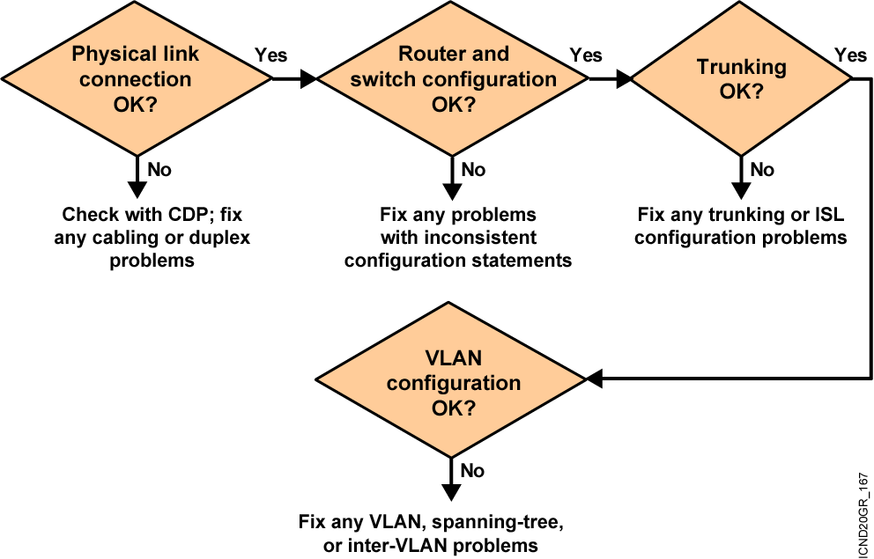
Troubleshooting Switched LANs

Slide 23
Problem: One Device Cannot Communicate with Another
  Make sure the IP address, subnet mask, and VLAN membership of the switch interface is correct.
  If the host is in the same subnet as the switch interface, make sure the switch interface and the switch port to which the host is connected are assigned to the same VLAN.
  If the host is in a different subnet, make sure the default gateway on the switch is configured with the address of a router in the same subnet as the switch interface.

Slide 24
Problem: One Device Cannot Communicate with Another (Cont.)
  If the port is in listening or learning mode, wait until the port is in forwarding mode and try to connect to the host again.
  Make sure the speed and duplex settings on the host and the appropriate switch ports are correct.
  If the connected device is an end station, enable spanning-tree PortFast, disable trunking, and disable chaneling on the port.
  Make sure the switch is learning the MAC address of
  the host.

Slide 25
Problem: A Device Cannot Establish a Connection Across a Trunk Link
  Make sure the trunking mode configured on both ends of the link is valid. The trunking mode should be on or desirable on one end and on, desirable, or auto on the other end.
  Make sure the trunk encapsulation type configured on both ends of the link is valid.
  On IEEE 802.1Q trunks, make sure the native VLAN is the same on both ends of the trunk.

Slide 26
Problem: VTP Not Updating Configuration on Other Switches
  Make sure the switches are connected through trunk links. VTP updates are exchanged only over trunk links.
  Make sure the VTP domain name is the same on the appropriate switches. VTP updates are only exchanged between switches in the same VTP domain.
  Check if the switch is in VTP transparent mode. Only switches in VTP server or VTP client mode update their VLAN configuration based on VTP updates from other switches.
  If you are using VTP passwords, you must configure the same password on all switches in the VTP domain.

Slide 27
Summary
  Before you create VLANs, you must decide whether to use VTP in your network. With VTP, you can make configuration changes centrally on one or more switches and have those changes automatically communicated to all the other switches in the network.
  You will configure IEEE 802.1Q to carry traffic for multiple VLANs over a single link on a multivendor network.
  ISL operates in a point-to-point environment to carry traffic for multiple VLANs over a single link.
  Most Catalyst desktop switches support a maximum of 64 active VLANs. The Catalyst 1900 supports 1,024 VLANs with the Enterprise Edition software. Depending on the model, the 2950 series can support up to 250 VLANs.
Notes:
Purpose: This slide discuss the initial configurations on the routers and switches.
Note: There is no setup mode on the Catalyst 1900 switch.

Slide 28
Summary (Cont.)
  After creating a VLAN, you can statically assign a port or a number of ports to that VLAN. A port can belong to only one VLAN at a time.
  You can verify the VLAN configuration using the show commands.
  As network topologies, business requirements, and individual assignments change, VLAN requirements also change.
  Misconfiguration of a VLAN is one of the most common errors in switched networks.

Slide 29
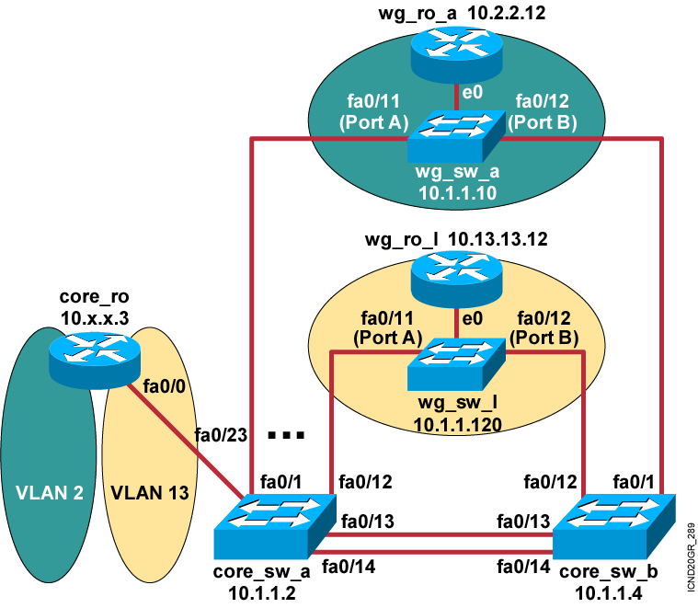
Visual Objective 4-1: Configuring a Switch for Extended Functionality
Subnet VLAN Pod
10.1.1.0 1 wg_sw_x, core_sw_a,
core_sw_b, core_ro
10.2.2.0 2 core_ro, wg_ro_a
10.3.3.0 3 core_ro, wg_ro_b
10.4.4.0 4 core_ro, wg_ro_c
10.5.5.0 5 core_ro, wg_ro_d
10.6.6.0 6 core_ro, wg_ro_e
10.7.7.0 7 core_ro, wg_ro_f
10.8.8.0 8 core_ro, wg_ro_g
10.9.9.0 9 core_ro, wg_ro_h
10.10.10.0 10 core_ro, wg_ro_i
10.11.11.0 11 core_ro, wg_ro_j
10.12.12.0 12 core_ro, wg_ro_k
10.13.13.0 13 core_ro, wg_ro_l
Notes:
Lab 7 and 8? changed port assignments wg switches added core_ro to vlan 1, added core addresses
Added VLAN info and wg routers.
Objectives: Students will see how the core router will interconnect separate VLANs.
Purpose: To interconnect networks.
Laboratory Instructions: This laboratory exercise is more of a demonstration, as the instructor is responsible for setting up the router on a stick. Refer to the lab setup guide.

Slide 30


